Slide 1

RAG Chatbot with Role-Based Access Control
Created by: Bhavya Jethwa

Slide 2
About the Project
Problem Statement:
"FinSolve Technologies, is a leading FinTech company providing innovative financial solutions and services to individuals, businesses, and enterprises. Recently, teams have been facing delays in communication and difficulty accessing the right data at the right time, which has led to inefficiencies
Solution:
Develop a RAG-based role-based access control system for the chatbot, ensuring each user receives the correct data based on their role. The chatbot should process queries, retrieve data, and generate context-rich responses.

Slide 3
Key Requirements
Authentication and Role Assignment: The chatbot should authenticate users and assign them their roles.
Data Handling: Respond to queries based on the corresponding department data (Finance, Marketing, HR, General, Engineering), also providing reference to the source document.
NLP: Process and understand natural language queries.
Role-Based Access Control: Ensure role-based data access.
RAG: Retrieve data, augment it with context, and generate a clear, insightful response.

Slide 4
Tech Stack used
Python 3.13 (Core programming language)
FastAPI (Backend API)
Streamlit (Frontend UI)
Passlib (Password Hashing)
LangChain (Document loading and splitting and RAG chain)
ChromaDB (Vector Store)
OpenAI (LLM and Embeddings)
SQLite (Database)
Langsmith (Tracing and monitoring)

Slide 5
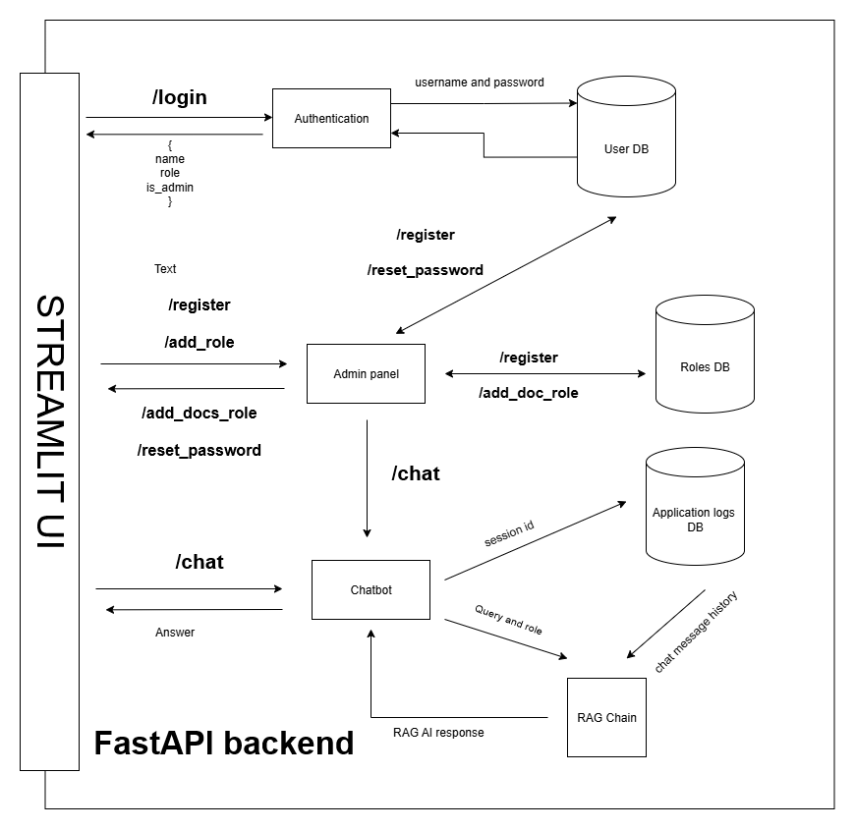
Project Architecture

Slide 6
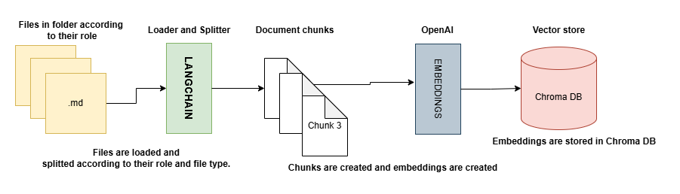
How are documents stored in Chroma DB

Slide 7
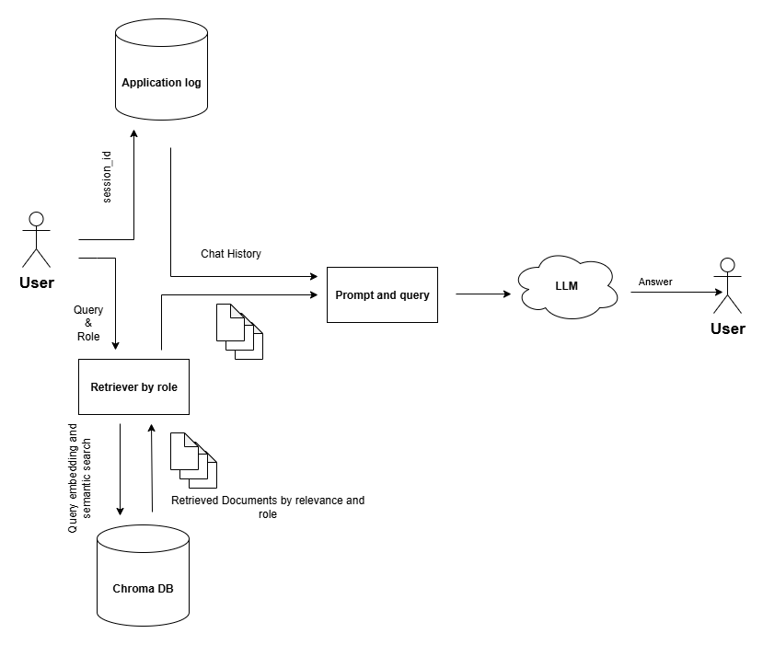
RAG Chain

Slide 8
Added Functionalities
Chat History to handle follow up question.
Smart chat history forwarding.
Clean-up script for better memory management.

Slide 9
Scalability and Extensibility
Register new users.
Add new roles.
Add new documents with dynamic loading and splitting.

Slide 10
Future enhancements
Oauth JWT for better security and authentication.
React frontend for a better UI.
Hosting LLM locally to improve latency of aur RAG.

Slide 11
DEMO

